Slide 1

History of VGA Graphics
By: Daniel Gopal

Slide 2
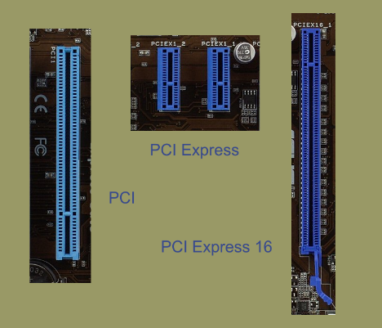

What are graphics cards
Also known as a graphics processing unit (GPU), graphics adapter, or video card
Type of display adapter or video card installed within most computing devices
A printed circuit board that enhances the video capabilities
To display graphical data with high clarity, color, definition and overall appearance
Provides high-quality visual display by processing and executing graphical data using advanced graphical techniques, features and functions.
Connected to the expansion slot of a computer

Slide 3


VGA and its display hardware
Video Graphics Array (VGA)
DE15
First introduced with the IBM PS/2 line of computers in 1987.
Through widespread adoption, the term has also come to mean either an analog computer display standard,
15-pin D-subminiature VGA connector
640×480 resolution

Slide 4
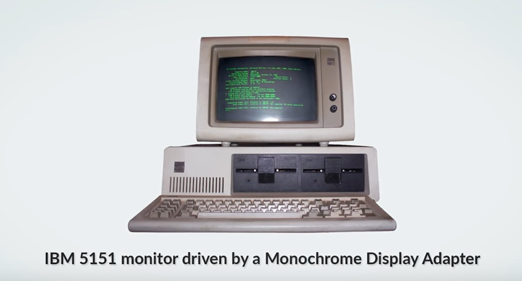
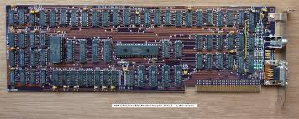
Who created it?
IBM monochrome display adapter
Created in 1981 by IBM
Made to replace a printer card Intel Model 8088
Resolution 720 x 350
Colors: 1
4kB of video memory

Slide 5
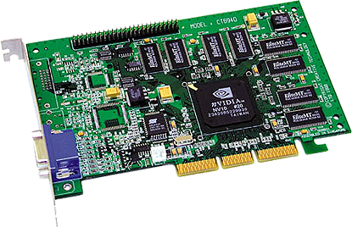


Who popularized it?
The term GPU was popularized by Nvidia in 1999
Who marketed the GeForce 256 as "the world's first GPU“ (Graphics Processing Unit)
It was presented as a "single-chip processor with 256-bit Graphics Core
Known as the first 3d graphics card
Max Resolution = 2048 x 1536
32 mb memory
A transition from 2d to the innovation of 3d
Price depends on use
Played really old games & programs

Slide 6




What it has innovated/evolved overtime to?
Modern graphics cards are usually marketed towards gamers
4k resolutions of exactly 3840 x 2160 pixels
Lower priced cards with resolutions being 1920 x 1080 pixels
Resolutions became higher
Memory (2/4 gb) and core clocks increased
Became more cheaper and affordable for the specs sold
Made for complex graphical use

Slide 7
Work Citied
Beal, V. (n.d.). GPU - graphics processing unit. Retrieved October 24, 2017, from https://www.webopedia.com/TERM/G/GPU.html
Brown, L. (2017, April 13). 4K VS 1080P: Why 4K is Better than 1080P. Retrieved October 24, 2017, from https://filmora.wondershare.com/video-editing-tips/4k-vs-1080p.html
IBM Monochrome Display Adapter. (n.d.). Retrieved October 23, 2017, from https://ipfs.io/ipfs/QmXoypizjW3WknFiJnKLwHCnL72vedxjQkDDP1mXWo6uco/wiki/IBM_Monochrome_Display_Adapter.html
“NVIDIA GeForce 256 DDR.” NVIDIA GeForce 256 DDR | VideoCardz.Net, VideoCardz.com, videocardz.net/nvidia-geforce-256-ddr/.
Tyson, J. (2001, March 16). How Graphics Cards Work. Retrieved October 23, 2017, from https://computer.howstuffworks.com/graphics-card.htm
(n.d.). Retrieved October 24, 2017, from http://www.nvidia.ca/page/geforce256.html

Slide 8
Thanks
For Listening

